Slide 1
Neural Speech Synthesis with Transformer Network
Naihan Li, Shujie Liu, Yanqing Liu, Sheng Zhao, Ming Liu University of Electronic Science and Technology of China Microsoft Research Asia Microsoft STC Asia

Slide 2
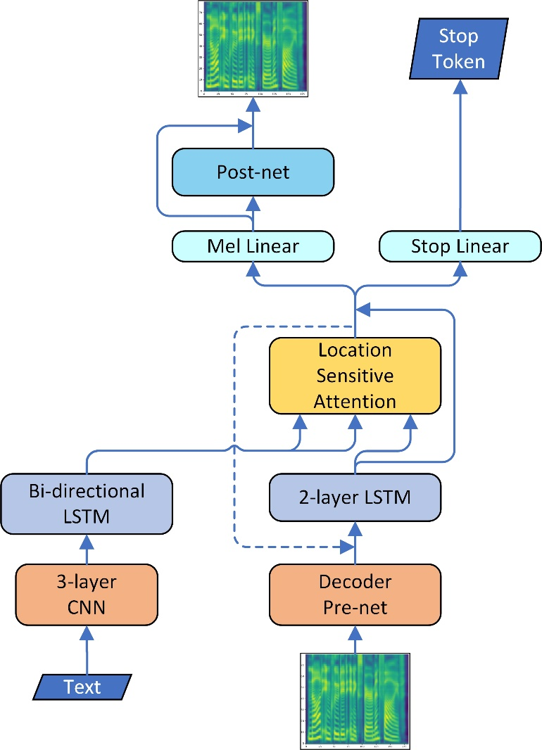
Tacotron2
A neural network architecture for speech synthesis directly from text
3-layer CNN: extracts a longer-term text context.
Bi-directional LSTM: encoder.
Location sensitive attention: connects encoder and decoder.
Decoder pre-net: a 2-layer fully connected network.
2-layer LSTM: decoder.
Mel linear: a fully-connected layer, generates mel spectrogram frames.
Stop linear: a fully-connected layer, predicts the stop token for each frame.
Post-net: a 5-layer CNN with residual connections, refines the mel spectrogram.

Slide 3
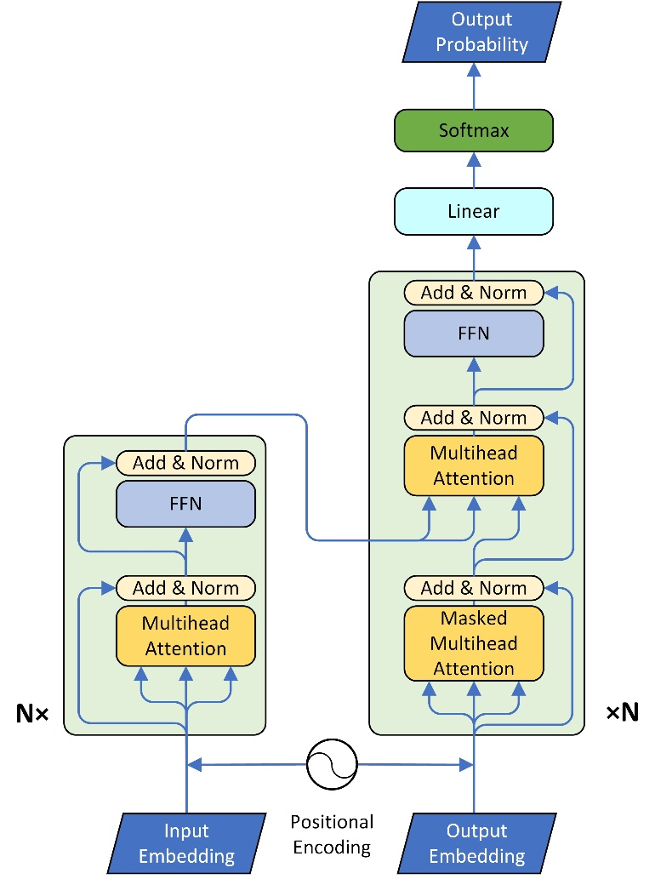
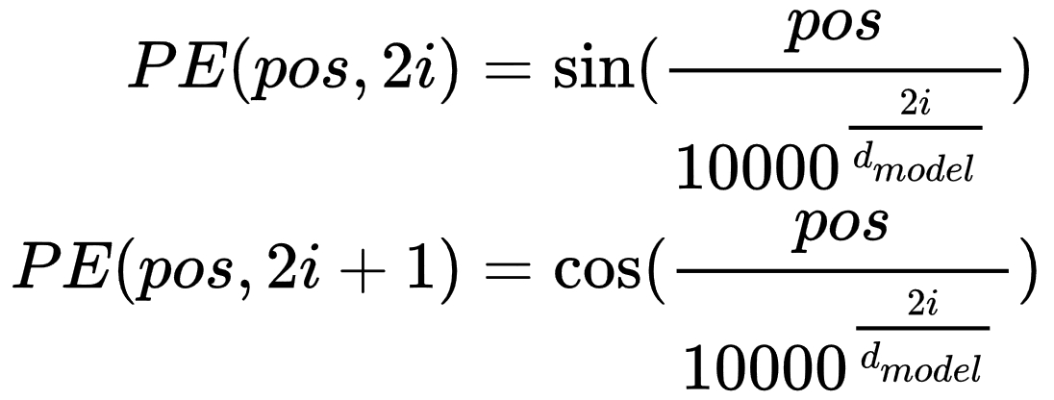
Transformer
A sequence to sequence network based solely on attention mechanisms
Encoder: 6 blocks.
Decoder: 6 blocks.
Positional embeddings: add positional information (PE) to input embeddings
(Masked) Multi-head attention:
Splits each Q, K and V into 8 heads
Calculates attention contexts respectively
Concatenates 8 context vectors
FFN: feed forward network, 2 fully connected layers.
Add & Norm: residual connection and layer normalization.

Slide 4
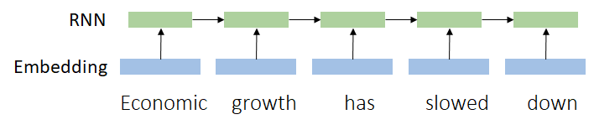
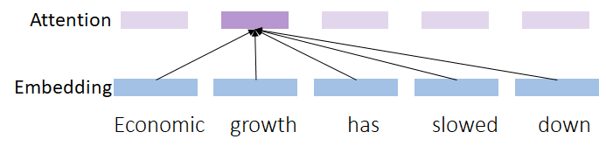
Neural TTS with Transformer
Why apply Transformer in TTS
Parallel training Frames of an input sequence can be provided in parallel.
Long range dependencies Self attention injects global context of the whole sequence into each input frame.

Slide 5

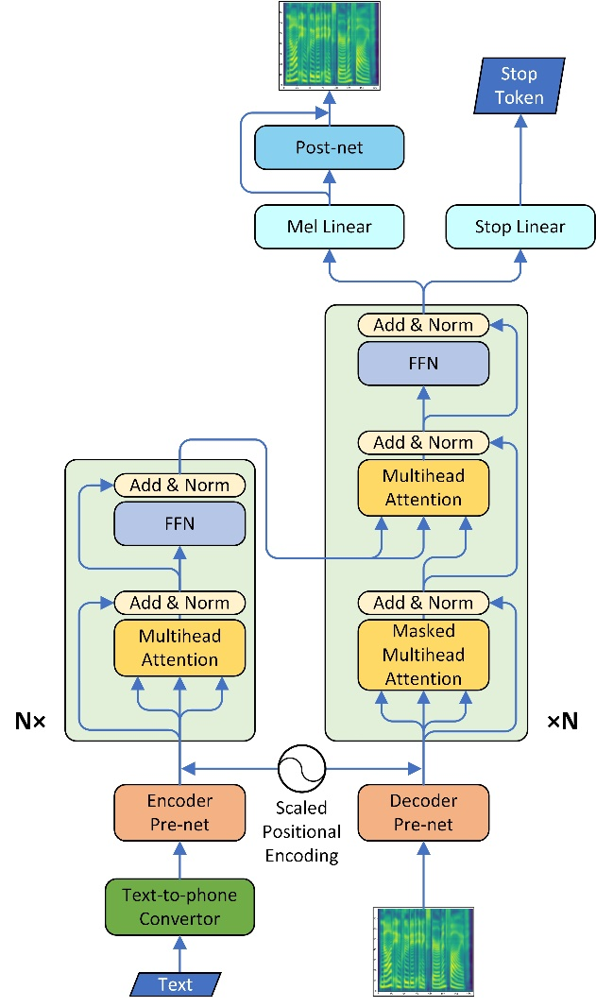
Neural TTS with Transformer

Slide 6
Neural TTS with Transformer
Text-to-Phoneme Converter
Difficult to learn all the regularities without sufficient training data
Some exceptions have too few occurrences for neural networks to learn
Convert text into phonemes by rule:
This is the waistline .
dh . ih . s / ih . z / dh . ax / w . ey . s . t - l . ay . n / punc.

Slide 7
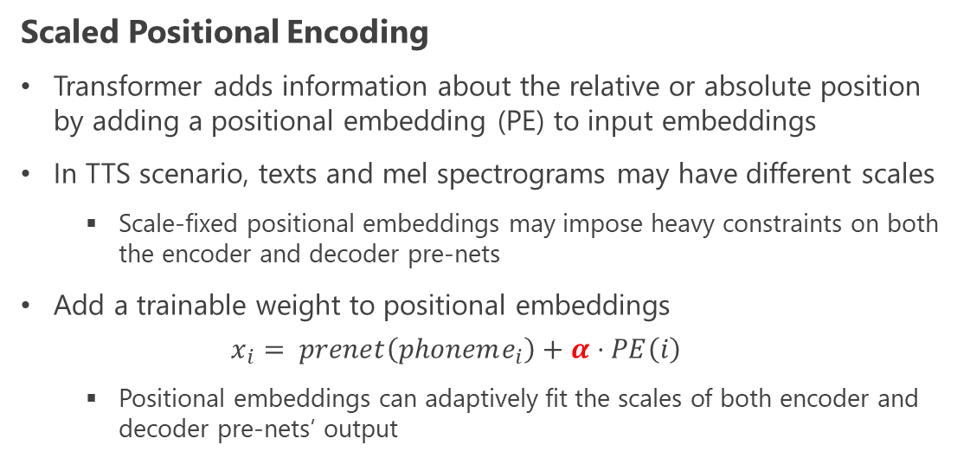
Neural TTS with Transformer
Scaled Positional Encoding
Transformer adds information about the relative or absolute position by adding a positional embedding (PE) to input embeddings
In TTS scenario, texts and mel spectrograms may have different scales
Scale-fixed positional embeddings may impose heavy constraints on both the encoder and decoder pre-nets
Add a trainable weight to positional embeddings
$$x_{i}= prenet\left(phoneme_{i}\right)+α⋅PE\left(i\right)$$
Positional embeddings can adaptively fit the scales of both encoder and decoder pre-nets’ output

Slide 8
Neural TTS with Transformer
Pre-nets of Encoder and decoder
Similar structure and function as in Tacotron2
An additional linear projection is appended
Positional embeddings are in [−1, 1]
After relu, the outputs of pre-nets are in [0, +∞)
Re-center to have a 0-centered range

Slide 9
Neural TTS with Transformer
Encoder and decoder
Model the frame relationship in multiple different aspects.
Inject the global context of the whole sequence into each frames.
Enable parallel computing to improve training speed.

Slide 10
Neural TTS with Transformer
Stop linear
Predicts whether should inference stop at current frame.
Unstoppable inference may occur
During training, each sequence has only one "stop" while hundreds of “continue”.
Imbalance positive/negative samples result in biased stop linear.
Solution: impose a weight (5.0 ∼ 8.0) on the "stop" token when calculating binary cross entropy loss during training.

Slide 11
Experiment
Training Setup
4 Nvidia Tesla P100
Internal US English female dataset
25-hour professional speech
17584 text-wave pairs
Dynamic batch size
Various sample number
Fixed mel spectrogram frame number
Text-to-Phoneme Conversion and Pre-process
Phoneme type:
Normal phonemes
Word boundaries
Syllable boundaries
Punctuations
Process pipeline:
Sentence separation
Text normalization
Word segmentation
Obtaining pronunciation
WaveNet Settings
Sample rate: 16000
Frame rate (frames per second): 80
2 QRNN layers
20 dilated layers
Residual and dilation channel size: 256

Slide 12
Experiment
Training Time Comparison
 | Tacotron2 | Transformer
Single step (batch size=~16) | ∼1.7s | ∼0.4s
Total time | ~4.5 days | ~3 days
Inference Time Comparison
 | Tacotron2 | Transformer
Synthesize 1s spectrogram | ∼0.13s | ∼0.36s

Slide 13
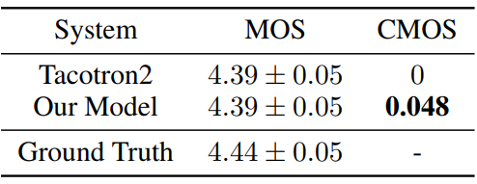
Evaluation
Evaluation setup
38 fixed examples with various lengths
Each audio is listened to by at least 20 testers (8 testers Shen et al. (2017))
Each tester listens less than 30 audios
Results
Baseline model
Tacotron2
Use phone sequence as inputs
Other structure are same as Google’s version
CMOS: comparison mean option score. Testers listen to two audios each time and evaluates how the latter feels comparing to the former using a score in [−3, 3] with intervals of 1

Slide 14

Evaluation
Generated sample comparison
Our model
Tacotron2
More samples at https://neuraltts.github.io/transformertts/

Slide 15
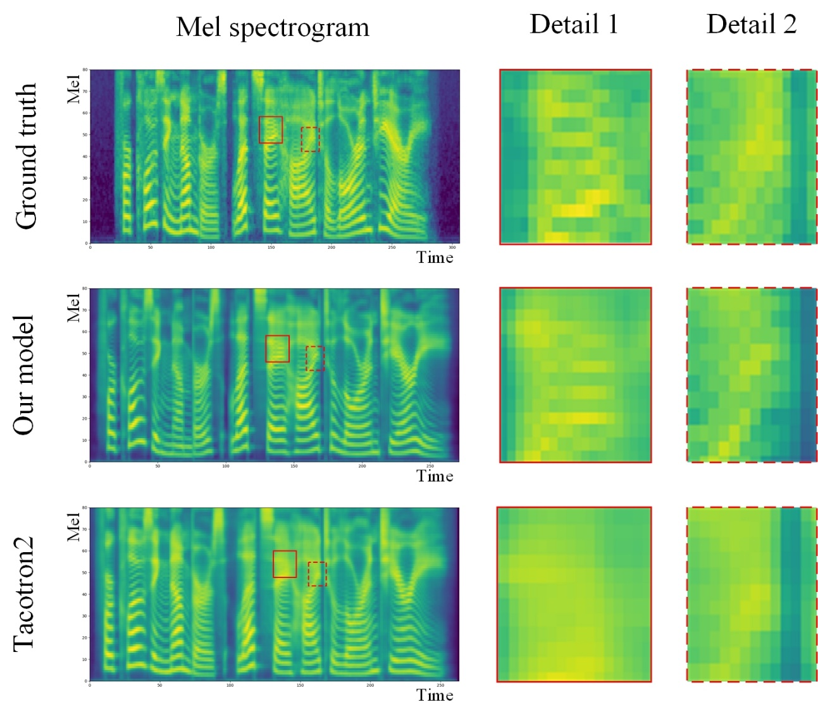
Evaluation
Mel spectrogram details
Our model does better in reproducing high frequency region

Slide 16
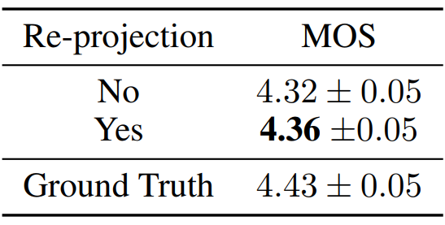
Ablation Studies
Re-centering Pre-net’s Output
Re-project pre-nets’ outputs for consistent center with positional embeddings
Center-consistent PE performs slightly better

Slide 17
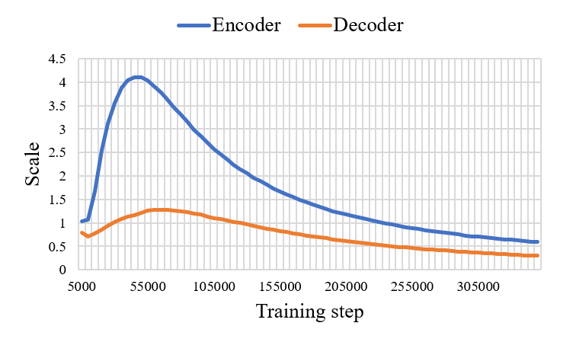
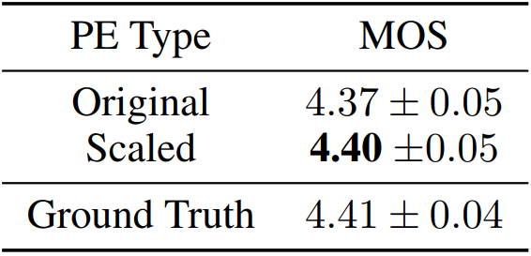
Ablation Studies
Different Positional Encoding Methods
Final positional embedding scales of encoder and decoder are different
Trainable scale performs slightly better.
Reason:
Constraint on encoder and decoder pre-nets are relaxes
Positional information are more adaptive for different embedding spaces

Slide 18




Ablation Studies
Different Hyper-Parameter: layer number impact
For encoder-decoder attention, only alignments from certain heads of the beginning 2 layers’ are interpretable diagonal lines
More layers can still refine the synthesized mel spectrogram and improve audio quality
Encoder input time step
Decoder input time step
Notes:
The reason is that with residual connection between different layers, our model fits target transformation in a Taylor-expansion way: the starting terms account most as low ordering ones, while the subsequential ones can refine the function

Slide 19
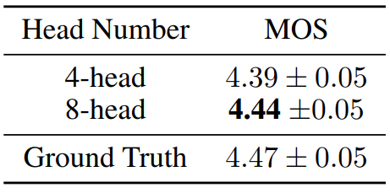
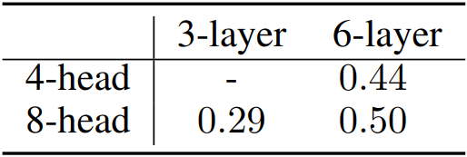
Ablation Studies
Different Hyper-Parameter: head number impact
Reducing head numbers harms performance
Comparison of time consuming (in second) per training step of different layer and head numbers
(Tested on 4 GPUs with dynamic batch size)

Slide 20
Thank you!

